Slide 1
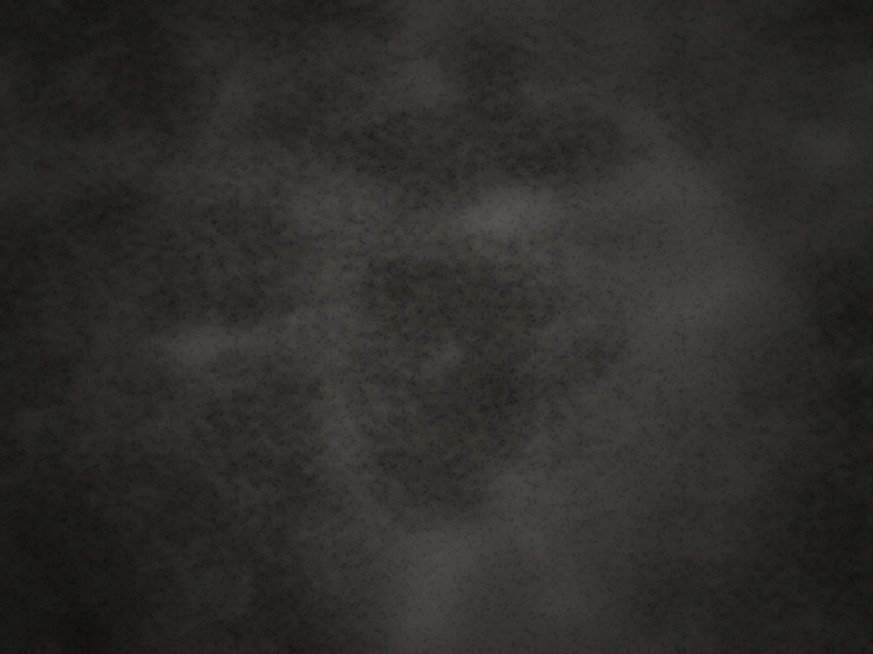
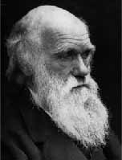
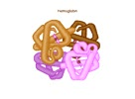
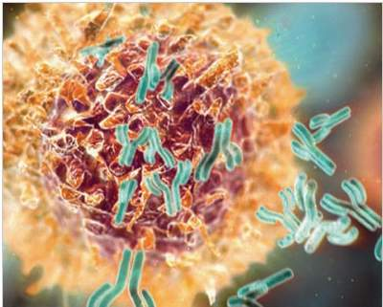
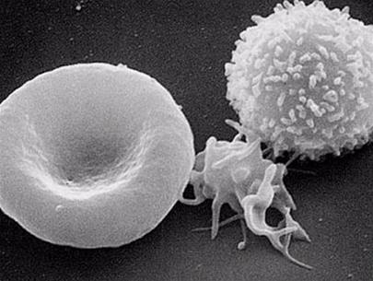
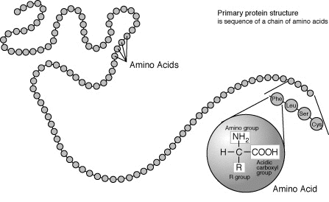
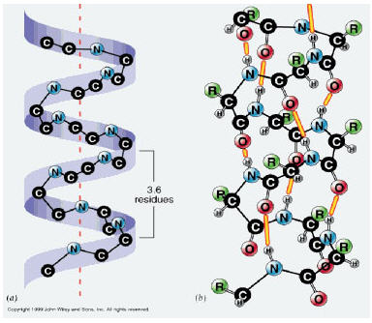
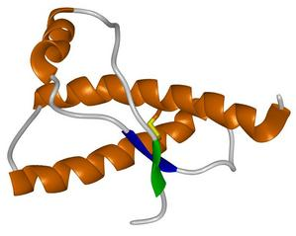
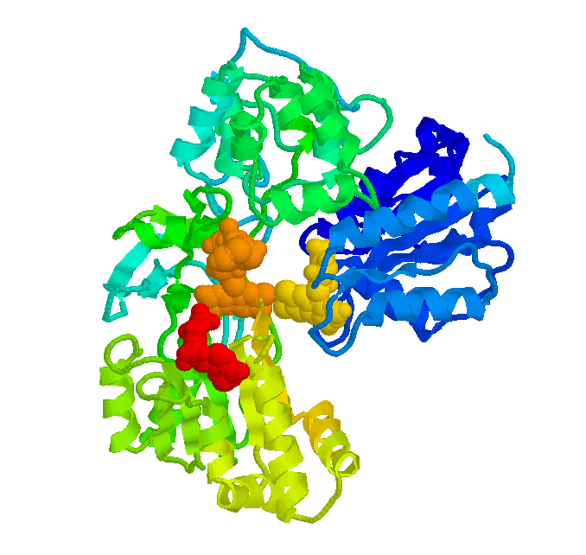
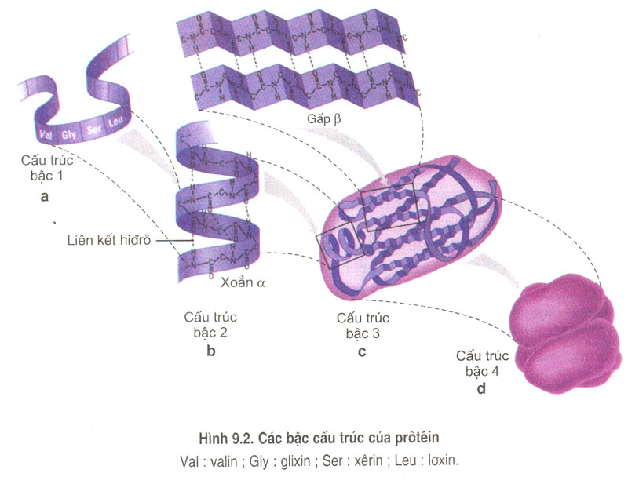

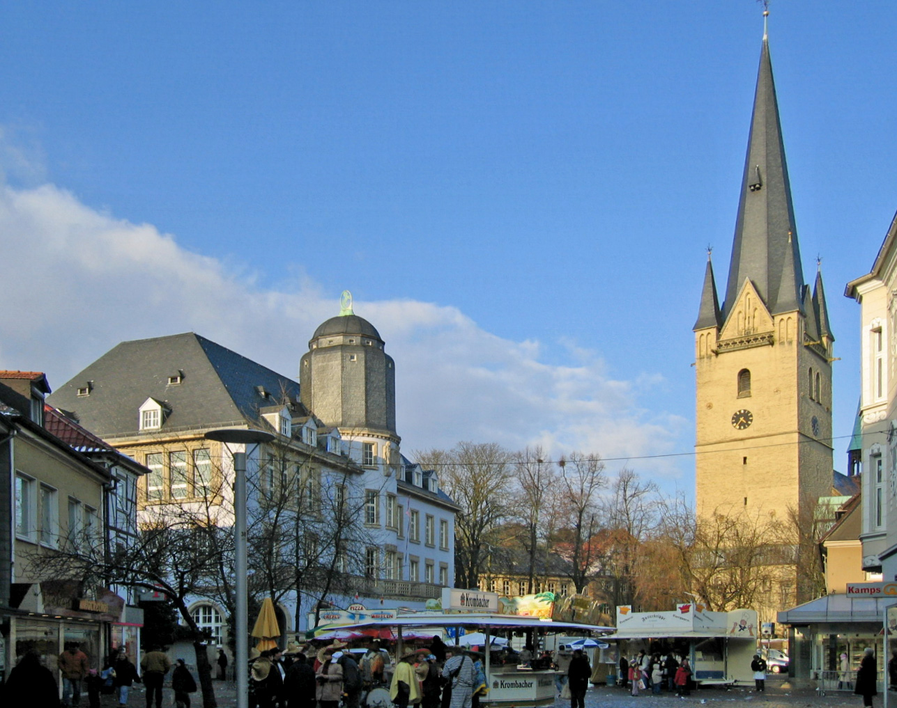
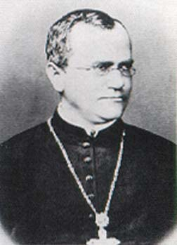
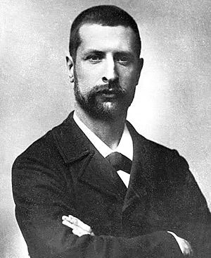
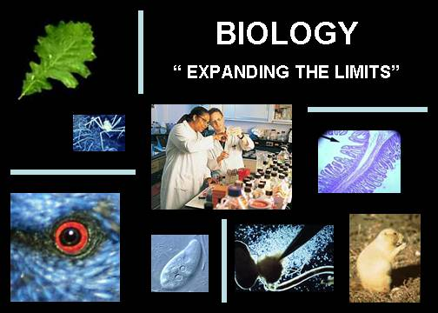



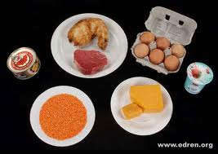
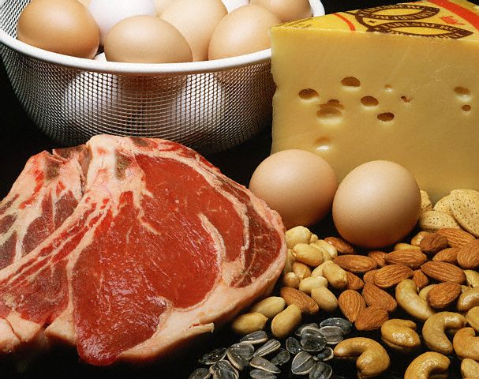
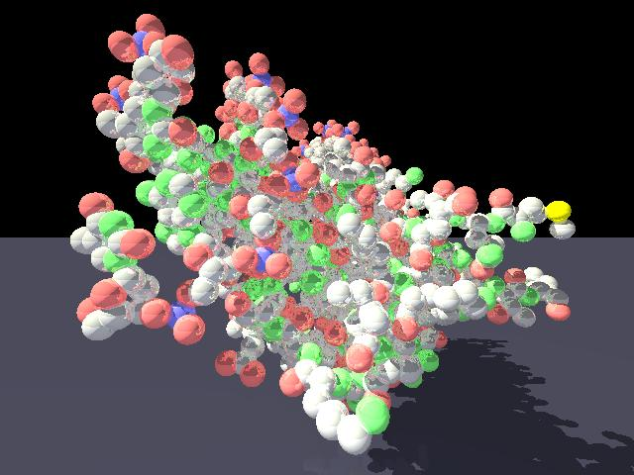
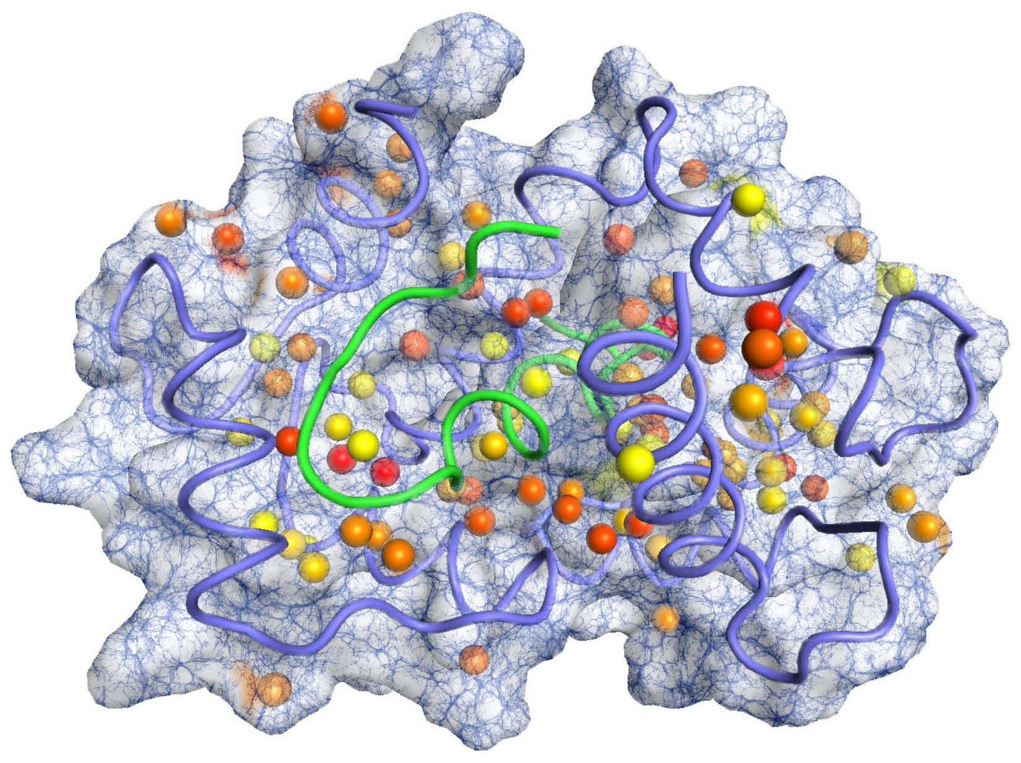
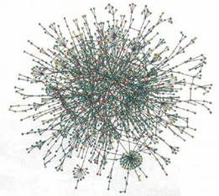
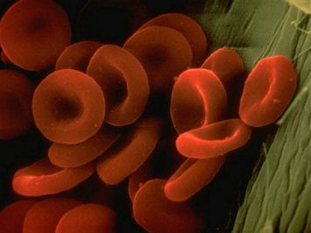
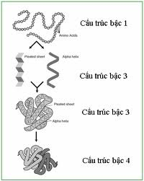
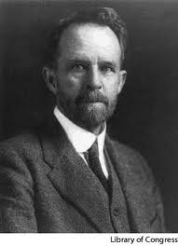


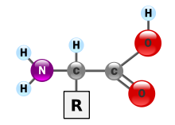



Slide 2

Sinh học 10
Protein
Notes:
Animated captions fade into view over forest background
(Basic)
To reproduce the rectangle on this slide, do the following:
On the Home tab, in the Slides group, click Layout, and then click Blank.
On the Home tab, in the Drawing group, click Shapes, and then under Rectangle click Rounded Rectangle (second option from the left). On the slide, drag to draw a rectangle.
Select the rectangle. Under Drawing Tools, on the Format tab, in the Size group, do the following:
In the Shape Height box, enter 3.08”.
In the Shape Width box, enter 4.33”.
Under Drawing Tools, on the Format tab, in the Shapes Styles group, click the arrow next to Shape Outline, and then click No Outline.
Under Drawing Tools, on the Format tab, in the bottom right corner in the Shapes Styles group, click the Format Shape dialog box launcher. In the Format Shape dialog box, click Fill in the left pane, select Gradient fill in the Fill pane, and then do the following:
In the Type list, select Linear.
In the Angle box, enter 90.
Under Gradient stops, click Add gradient stops or Remove gradient stops until two stops appear in the slider.
Also under Gradient stops, customize the gradient stops as follows:
Select the first stop in the slider, and then do the following:
In the Position box, enter 0%.
Click the button next to Color, and then under Theme Colors click White, Background 1 (first row, first option from the left).
In the Transparency box, enter 25%.
Select the next stop in the slider, and then do the following:
In the Position box, enter 20%.
Click the button next to Color, and then under Theme Colors click White, Background 1 (first row, first option from the left).
In the Transparency box, enter 69%.
Also in the Format Shape dialog box, click Shadow in the left pane. In the Shadow pane, click the button next to Presets, under Outer click Offset Diagonal Bottom Left (first row, third option from the left), and then do the following:
In the Transparency box, enter 72%.
In the Size box, enter 100%.
In the Blur box, enter 11.81 pt.
In the Angle box, enter 141°.
In the Distance box, enter 19.7 pt.
Also in the Format Shape dialog box, click 3-D Format in the left pane, and then do the following in the 3-D Format pane:
Under Bevel, click the button next to Top, and then under Bevel click Circle (first row, first option from the left). Next to Top, in the Width box, enter 7 pt, in the Height box, enter 7 pt.
Under Surface, click the button next to Material, and then under Standard click Metal (fourth option from the left). Click the button next to Lighting, and then under Neutral click Contrasting (second row, second option from the left). In the Angle box, enter 75°.
On the slide, drag the rectangle near the bottom right corner.
To reproduce the rectangle animation effects on this slide, do the following:
On the slide, select the rectangle. On the Animations tab, in the Advanced Animation group, click Add Animation, point to Entrance, and then click More Entrance Effects. In the Add Entrance Effect dialog box, under Moderate, click Float Up.
Also on the Animations tab, in the Timing group, do the following:
in the Start list, select With Previous.
In the Duration list, enter 02.00.
To reproduce the text effects on this slide, do the following:
On the Insert tab, in the Text group, click Text Box, and then on the slide, drag to draw the text box.
Enter three lines of text with paragraph breaks in the text box.
Select the text, and then on the Home tab, in the Font group, do the following:
In the Font list, select Candara.
In the Font Size list, select 28.
Click the arrow next to Font Color, and then under Theme Colors click Aqua, Accent 5; Darker 50% (sixth row, ninth option from the left).
On the Home tab, in the Paragraph group, click Align Text Left to position the text left in the text box.
On the slide, drag the text box onto the rectangle.
To reproduce the text animation effects on this slide, do the following:
On the slide, select the text box. On the slide, select the rectangle. On the Animations tab, in the Advanced Animation group, click Add Animation, point to Entrance, and then click More Entrance Effects. In the Add Entrance Effect dialog box, under Moderate, click Float Down.
Also on the Animations tab, in the Animation group, click the Show Additional Effect Options dialog box launcher. In the Float Down dialog box, do the following:
On the Timing tab, in the Start box, select With Previous.
In the Duration box, select 1 seconds (Fast).
On the Text Animation tab, in the Group text list, select By 1st Level Paragraphs.
Also on the Animations tab, in the Advanced Animation group, click Animation Pane. In the Animation Pane, click the double arrow under the text animation effect to expand the list of effects, and then do the following:
Select the first text animation effect in the list (descend effect for the first line of text). Click the arrow to the right of the selected effect, and then click Timing. In the Descend dialog box, on the Timing tab, in the Delay box, enter 1.
Select the second text animation effect (descend effect for the second line of text). Click the arrow to the right of the selected effect, and then click Timing. In the Descend dialog box, on the Timing tab, do the following:
In the Start list select With Previous.
In the Delay box, enter 1.5.
Select the third text animation effect (descend effect for the third line of text). Click the arrow to the right of the selected effect, and then click Timing. In the Descend dialog box, on the Timing tab, do the following:
In the Start list select With Previous.
In the Delay box, enter 2.
To reproduce the background effects on this slide, do the following:
On the Design tab, in the Background group, click the Format Background dialog box launcher.
In the Format Background dialog box, click Fill in the left pane, select Picture or texture fill in the Fill pane, and then under Insert from click File.
In the Insert Picture dialog box, select a picture, and then click Insert.

Slide 3
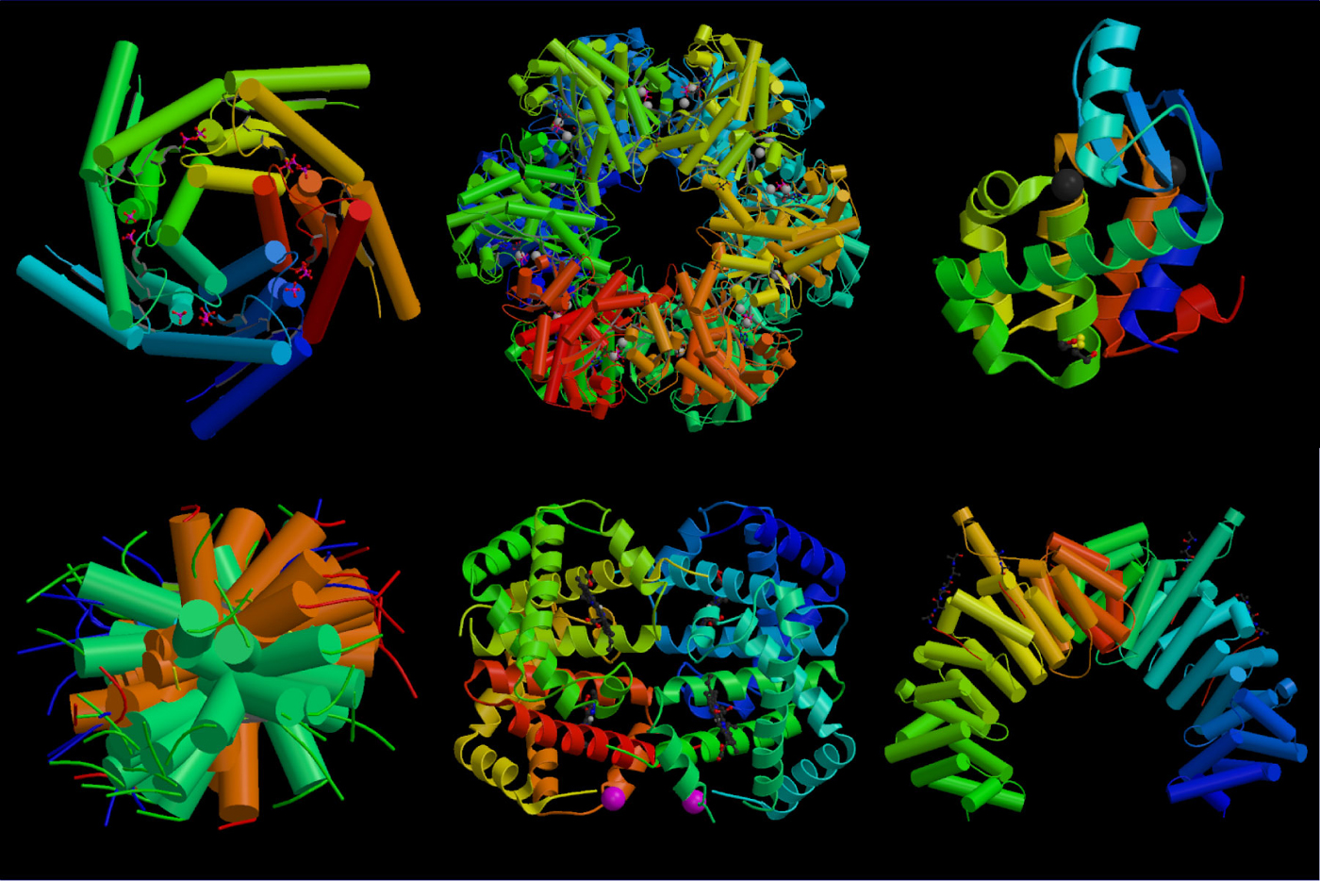

+Khái niệm
+Cấu trúc của Protein
+Chức năng của Protein
Notes:
Animated title moves behind picture
(Intermediate)
To reproduce the shape effects on this slide, do the following:
On the Home tab, in the Slides group, click Layout, and then click Blank.
On the Home tab, in the Drawing group, click Shapes, and then under Rectangles click Rectangle (first option from the left). On the slide, drag to draw a rectangle.
Select the rectangle. Under Drawing Tools, on the Format tab, in the Size group, do the following:
In the Shape Height box, enter 3.17”.
In the Shape Width box, enter 9.5”.
Drag the rectangle slightly above the middle of the slide.
Select the rectangle. On the Home tab, in the Drawing group, click Arrange, point to Align, and then do the following:
Click Align to Slide.
Click Align Left.
Under Drawing Tools, on the Format tab, in the Shape Styles group, click the next to Shape Outline, and then click No Outline.
Under Drawing Tools, on the Format tab, in the Shape Styles group, click the Format Shape dialog box launcher. In the Format Shape dialog box, click Fill in the left pane, select Gradient fill in the Fill pane, and then do the following:
In the Type list, select Linear.
In the Angle box, enter 0.
Under Gradient stops, click Add gradient stops or Remove gradient stops until two stops appear in the slider.
Also under Gradient stops, customize the gradient stops as follows:
Select the first stop in the slider, and then do the following:
In the Position box, enter 0%.
Click the button next to Color, and then under Theme Colors click Orange, Accent 6, Darker 50% (fifth row, 10th option from the left).
Select the next stop in the slider, and then do the following:
In the Position box, enter 100%.
Click the button next to Color, and then under Theme Colors click Orange, Accent 6, Darker 25% (fourth row, 10th option from the left).
To reproduce the “heading” text box on this slide, do the following:
On the Insert tab, in the Text group, select Text Box. On the slide, drag to draw a text box.
Enter the heading text, and then select text. On the Home tab, in the Font group, do the following:
In the Font list, select Calibri.
In the Font Size box, enter 38.
Click Bold.
Click the arrow next to Font Color, and then under Theme Colors click Orange, Accent 6, Darker 25% (fourth row, 10th option from the left).
On the Home tab, in the Paragraph group, click Align Text Left.
Drag the text box just above the rectangle, in the right half of the slide.
To reproduce the second text box on this slide, do the following:
On the Insert tab, in the Text group, click Text Box. On the slide, drag to draw a text box.
Enter three lines of text with paragraph breaks, and then select the text. On the Home tab, in the Font group, do the following:
In the Font list, select Calibri.
In the Font Size list, select 28.
Click Bold.
Click the arrow next to Font Color, and then under Theme Colors click White, Background 1 (first row, first option from the left).
On the Home tab, in the Paragraph group, click the Paragraph dialog box launcher. In the Paragraph dialog box, do the following:
On the Indents and Spacing tab, under General, select Left in the Alignment box.
Under Spacing, select 12 in the After box.
Drag the second text box onto the rectangle, below the “heading” text box.
To reproduce the full-color picture on this slide, do the following:
On the Insert tab, in the Images group, click Picture. In the Insert Picture dialog box, select a picture, and then click Insert.
On the slide, select the picture. Under Picture Tools, on the Format tab, in the Size group, click the Size and Position dialog box launcher. In the Format Picture dialog box, resize or crop the image so that the height is set to 5.08” and the width is set to 2.61”. To crop the picture, click Crop in the left pane, and in the right pane, under Crop position, enter values into the Height, Width, Left, and Top boxes. To resize the picture, click Size in the left pane, and in the right pane, under Size and rotate, enter values into the Height and Width boxes.
Also in the Format Picture dialog box, click Glow and Soft Edges in the left pane, and then, in the Glow and Soft Edges pane, do the following:
Under Glow, click the button next to Presets, and then click Blue, 5 pt glow Accent color 1 (first row, first option from the left).
Click the button next to Color, and then under Theme Colors click White, Background 1 (first row, first option from the left).
Drag the full-color picture on top of the rectangle, to the left of the text boxes.
On the Home tab, in the Drawing group, click Arrange, point to Align, and then do the following:
Click Align to Slide.
Click Align Top.
To reproduce the second picture on this slide, do the following:
On the Insert tab, in the Images group, click Picture. In the Insert Picture dialog box, select the same picture, and then click Insert.
On the slide, select the picture. On the slide, select the picture. Under Picture Tools, on the Format tab, in the Size group, click the Size and Position dialog box launcher. In the Format Picture dialog box, resize or crop the image so that the height is set to 2.44” and the width is set to 2.61”. To crop the picture, click Crop in the left pane, and in the right pane, under Crop position, enter values into the Height, Width, Left, and Top boxes. To resize the picture, click Size in the left pane, and in the right pane, under Size and rotate, enter values into the Height and Width boxes.
On the slide, drag the new picture directly below the first one, and then, in the Format Picture dialog box, in the Crop tab, under Picture Position, adjust the Offset X and Offset Y settings to align the content of the two images so that they appear continuous.
Also in the Format Picture dialog box, click Picture Corrections in the left pane, and in the Picture Corrections pane, under Brightness and Contrast, do the following:
In the Brightness box, enter 70%.
In the Contrast box, enter -70%.
Select the smaller picture. On the Home tab, in the Drawing group, click Arrange, point to Align, and then do the following:
Click Align to Slide.
Click Align Bottom.
Press and hold CTRL, and then select both pictures. On the Home tab, in the Drawing group, click Arrange, point to Align, and then do the following:
Click Align Selected Objects.
Click Align Center.
To reproduce the animation effects on this slide, do the following:
On the slide, select the “heading” text box. On the Animations tab, in the Advanced Animation group, click Add Animation, and then under Entrance click Fade.
On the Animations tab, in the Timing group, in the Start list, select With Previous.
On the Animations tab, in the Timing group, in the Duration box, enter 2.
On the Animations tab, in the Timing group, in the Delay box, enter 1.5.
On the slide, select the “heading” text box. On the Animations tab, in the Advanced Animation group, click Add Animation, and then under Motion Paths click Lines.
On the Animations tab, in the Timing group, in the Start list, select With Previous.
On the Animations tab, in the Timing group, in the Duration box, enter 2.
On the Animations tab, in the Animation group, click Effect Options, and then click Left.
On the Animations tab, in the Animation group, click Effect Options, and then click Reverse Path Direction.
On the slide, select the motion path for the “heading” text box, point to the starting point (green arrow) of the motion path until the cursor becomes a two-headed arrow. Press and hold SHIFT, and then drag the starting point about 1.5” off the left edge of the slide. (Note: If your lines of text are longer than in the example above, you may need to further increase the length of the motion path. )
On the slide, select the second text box. On the slide, select the “heading” text box. On the Animations tab, in the Advanced Animation group, click Add Animation, and then under Entrance click Fade.
On the Animations tab, in the Animation group, click the Show Additional Effect Options dialog box launcher. In the Fade dialog box, do the following:
On the Effect tab, in the Animate text list, select By Letter.
In the % delay between letters box, enter 5.
On the Timing tab, in the Start list, select After Previous.
In the Duration list, select 0.5 seconds (Very Fast).
On the Text Animation tab, in the Group text list, select By 1st Level Paragraphs.
To reproduce the background on this slide, do the following:
One the Design tab, in the Background group, click Background Styles, and then click Format Background. In the Format Background dialog box, click Fill in the left pane, select Gradient fill in the Fill pane, and then do the following:
In the Type list, select Radial.
Click the button next to Direction, and then click From Center (third option from the left).
Under Gradient stops, click Add gradient stops or Remove gradient stops until three stops appear in the slider.
Also under Gradient stops, customize the gradient stops as follows:
Select the first stop in the slider, and then do the following:
In the Position box, enter 0%.
Click the button next to Color, and then under Theme Colors click White, Background 1 (first row, first option from the left).
In the Transparency box, enter 0%.
Select the next stop in the slider, and then do the following:
In the Position box, enter 40%.
Click the button next to Color, and then under Theme Colors click White, Background 1 (first row, first option from the left).
In the Transparency box, enter 0%.
Select the next stop in the slider, and then do the following:
In the Position box, enter 100%.
Click the button next to Color, click More Colors, and then in the Colors dialog box, on the Custom tab, enter values for Red: 232, Green: 227, and Blue: 216.

Slide 4
+Khái niệm:
*Protein :
_ đại phân tử hữu cơ
_ chiếm tới 50% khối lượng khô của hầu hết các loại tế bào
=> Protein có vai trò quan trọng đặc biệt với cơ thể sống

Slide 5
Bài 5: Protein
Cấu trúc của Protein

Slide 6
Bài 5: Protein
+Cấu trúc của Protein
Cấu trúc hoá học:
H
H
N
C
R
O
C
OH
H

Slide 7
Bài 5: Protein
+Cấu trúc của Protein
Cấu trúc hoá học:
Câu hỏi thảo luận:
_Tính đa dạng cao của protein do cấu tạo từ 20 loại axit amin.
*Vì sao protein có tính đa dạng và đặc thù?
_Tính đặc thù của protein do: số lượng thành phần,
+Số lượng thành phần, trình tự phân bố của
các chuỗi polipeptit trong mỗi phân tử protein.
+Do các kiểu cấu trúc không gian của các loại protein
để thực hiện các chức năng sinh học

Slide 8
Bài 5: Protein
+Cấu trúc của Protein
+Cấu trúc không gian:
Cấu trúc bậc 1
Đặc điểm:gồm các axit amin nối với nhau bởi liên kết peptit tạo nên chuôi polipeptit
Cấu trúc bậc 2
Đặc điểm: là cấu hình của chuỗi polipeptit trong không gian được giữ vững nhờ các liên kết hidro giữa các a.a gần nhau
Cấu trúc bậc 3
Đặc điểm: là hình dạng của phân tử protein trong không gian 3 chiều do xoắn cấp II cuốn theo kiểu đặc trưng cho mỗi loại protein tạo thành khối hình cầu
Cấu trúc bậc 4
Dặc điểm: là những protein gồm 2 hay nhiều chuỗi polipeptit kết hợp với nhau

Slide 11
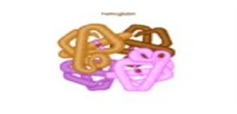

Slide 12
Bài 5: Protein
+Chức năng của protein:
+ Cấu trúc,xúc tác và điều hoà quá trình trao đổi chất
+Vận chuyển, chuyển động
+Bảo vệ
+Cung cấp năng lượng
+Chống đỡ cơ học
+Truyển xung thần kinh

Slide 13
Bài 5: Protein
Quá trình vận chuyển oxi được tiến hành nhờ các protein như hêmôglôbin( ở động vật có xương sống) và hêmôxiani(ở động vật không sương sống).

Slide 14
Bài 5: Protein
Ngoài các kháng thể có trong máu.còn có những kháng thể gọi là Inteferôn nằm trên bề mặt các tế bào đặc biệt,có thể nhận biết và bắt các tế bào lạ trong đó có các virut gây bệnh

Slide 15
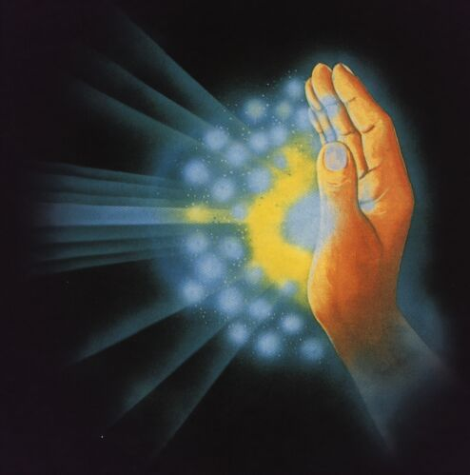
Bài 5: Protein
Lúc thiếu gluxit hoặc lipit, protein dược phân giải để cung cấp năng lượng cho quá trình hoạt động của tế bào.

Slide 16
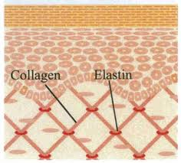
Bài 5: Protein
Cơ thể động vật có sức căng lớn của da và xương là nhờ collagen elastin:là các protein dạng sợi, nó bảo đảm độ bền, tính mềm dẻo của mô liên kết.

Slide 17
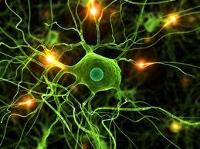
Bài 5: Protein
Rôdôpxin là protein cảm nhận ánh sáng có ở tế bào võng mạc mắt,nó được tự tổng hợp khi điều kiện ánh sáng yếu

Slide 18


Phạm Hoàng Anh
The team 4 Promotion
BY DIRECTOR X
Võ Anh Minh
Võ Danh Hoàng Bảo
Nguyễn Học Huy
AP PRODUCTION

